Slide 1
Robust Cybersecurity Threat Detection System
Submitted in the partial fulfillment for the award of the degree of
BACHELOR OF ENGINEERING
IN
DevOps
Submitted by:
Aaryan Maheshwari – 22BDO10001
Chayan Gope – 22BDO10036
Under the Supervision of:
Ms. Mamta(E15565)
Department of AIT-CSE
DISCOVER . LEARN . EMPOWER

Slide 2
Outline of Our Presentation
Introduction to Cybersecurity Threat Detection
Why do we Need a robust system?
Problem definition
Objectives of our Work
Proposed Solution & its Approach
List of Requires Software
Implementation
Conclusion
Future Scope

Slide 3

Introduction to Cybersecurity Threat Detection
Increasing Importance of Cybersecurity:
The digital landscape is expanding at a rapid rate, increasing dependency on networked systems.
As the digital infrastructures change, they are more prone to be under cyber threats, which are rapidly becoming sophisticated and are happening with increasing frequency.

Slide 4
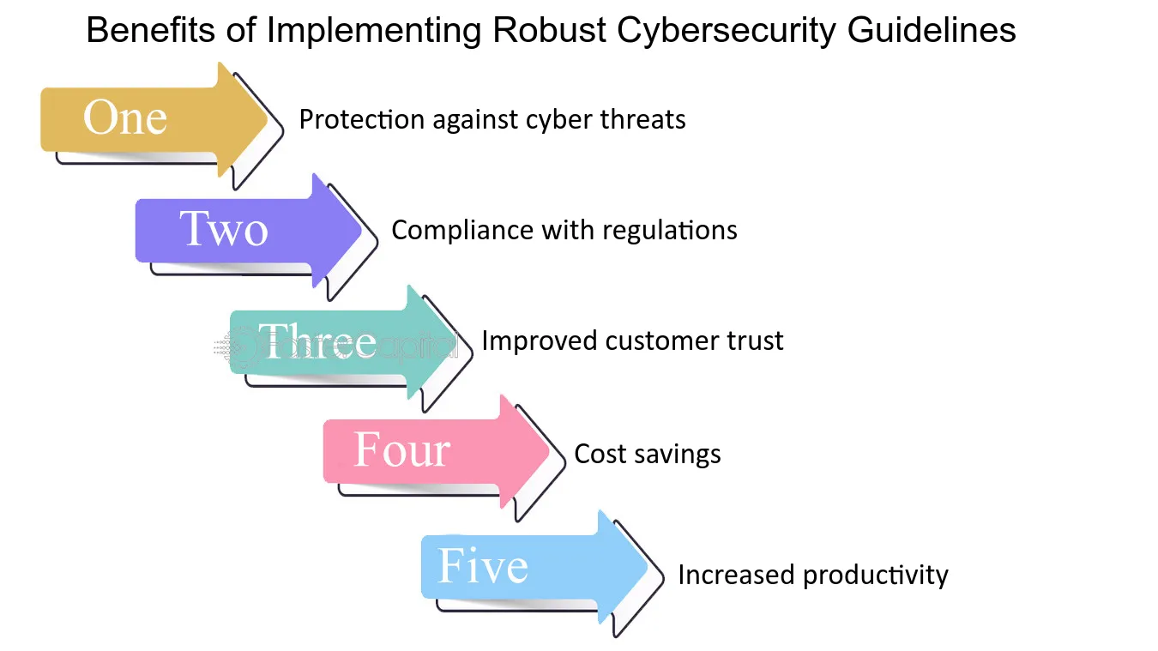
Why Do We Need a Robust Cybersecurity Solution?
Increasing Rate of Cyber Attacks: The rate of cyberattacks is rising tremendously, with data breaches growing by 67% in the last five years alone.
Drawbacks of the Existing Cyber Security Systems: There are two main problems regarding traditional cyber security systems
High False Positives: Traditional systems flag legitimate activity as threats, creating alert fatigue and resource waste.
Delayed Response Times: Many systems are reactive, detecting threats only after they have made damage.

Slide 5

Problem Definition
Increasing frequency and sophistication of cyber threats will continue to be the most critical threat to businesses, people, and infrastructure at large. Traditional cybersecurity systems tend to use single signatures as detection and rule-based algorithms with quite often high false positives, delayed responses, or even missed detection of unknown attacks. It leaves the systems vulnerable to breach incidents and compromises data security and trust.
The research is aimed at filling the gap in the provision of adaptive AI-driven cybersecurity threat detection systems that integrate machine learning and deep learning with behavioral analysis for enhancing the system's accuracy and adaptability. The Hybrid AI-Driven Cybersecurity Threat Detection System proposed in this study detects known as well as emerging threats and is designed to execute operations in real time to provide a proactive and scalable approach over current solutions that improve security and resilience in the face of changing cyber risks.

Slide 6

Objectives of the Work
⁠⁠Develop a comprehensive threat detection framework using machine learning algorithms.
⁠Implement real-time monitoring and alerting mechanisms for detecting and responding to cyber threats.
⁠Ensure the system can classify different types of threats accurately.
Integrate the system with existing network infrastructure and security tools.
Conduct extensive testing to evaluate the system's effectiveness and robustness.

Slide 7
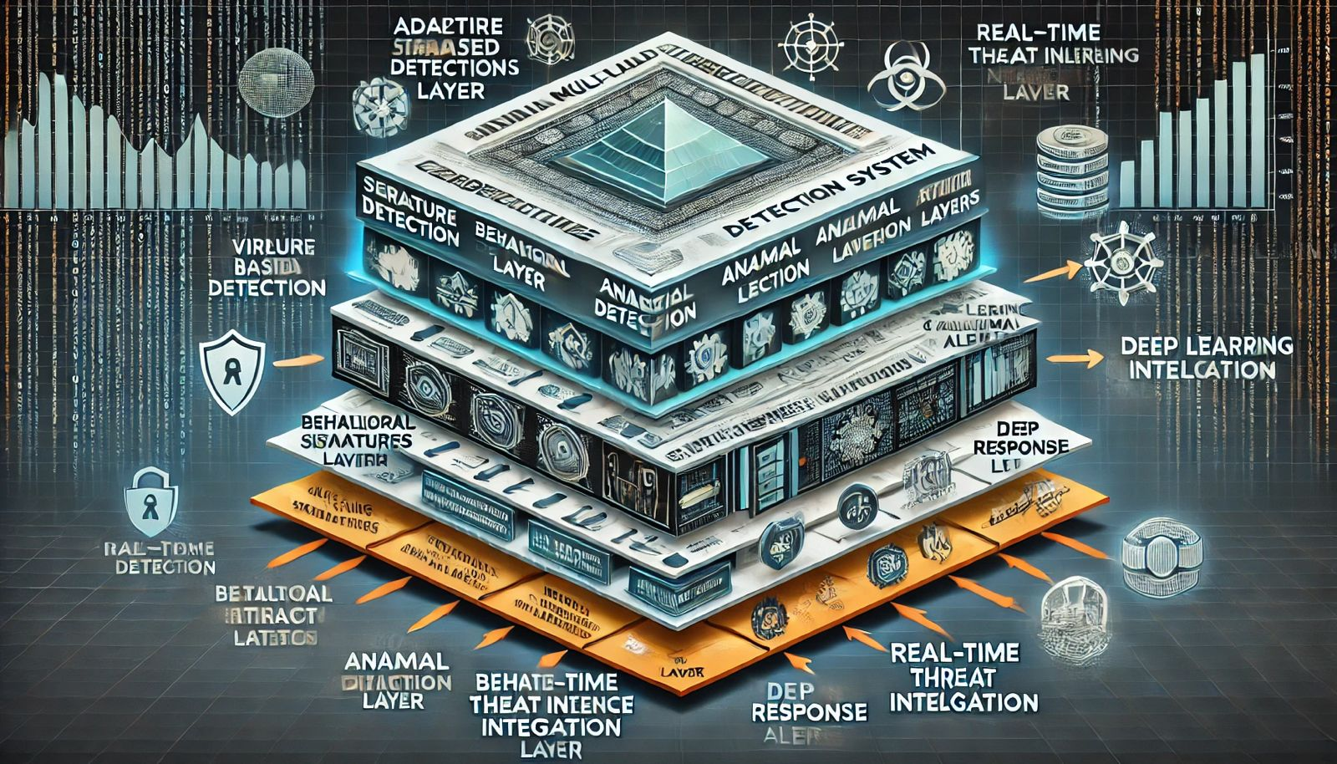
Proposed Solution & its Approach
To offer solutions to the limitations of existing cybersecurity solutions whilst increasing resilience against evolving threats, we propose an Adaptive Multi-Layered Cybersecurity Threat Detection System. This is an advanced solution composed of several approaches at different layers, leveraging the advantages of machine learning (ML), deep learning (DL), and real-time threat intelligence, whilst integrating behavioral analysis and anomaly detection to provide a fully adaptive solution.
Integration of Multi-Detection Layers: In this system, it is taken advantage of several layers of detection that may include signatures, anomalies, and behavioral analysis. Thus, it looks upon cyber threats in more ways than one to increase its effectiveness in defense. In this manner, the system can identify threats at different stages and types so that the system becomes more robust and extensive in its scope

Slide 8
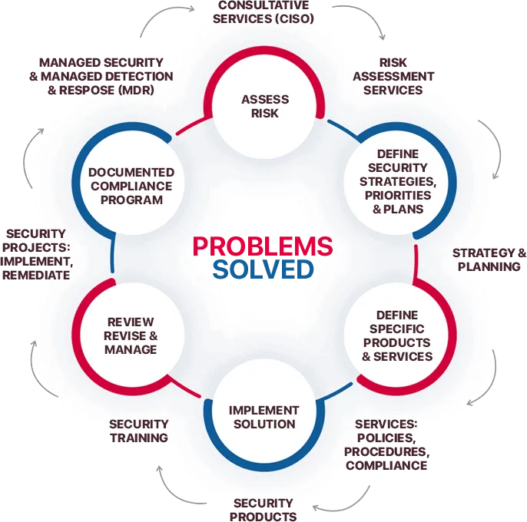
Proposed Solution & its Approach
Adaptive threat detection: The system is based on advanced ML and DL algorithms, so it adapts always to new, changing threats.
Real-time Threat Intelligence: It comes through access to present information on known attack methods, malicious IPs, and emerging vulnerabilities. Through those integrated feeds, it knows of probable threats in ad
Comprehensive Anomaly Detection: Since anomaly detection is generally the approach that looks for unusual patterns or behavior in the system, it indicates that this would expose to the system possible anomalies that could be manifestations of an attack.
Behavioral Analysis for Enhanced Detection Behavioral analysis adds another layer of detection since it tracks the activity of the user and the system processes for risky behaviors that might point to an insider attack or an advanced attack

Slide 9
List of Required Software
Languages
Cloud Services
Programming Languages: Python (for machine learning models), JavaScript (for front-end and real-time data visualization), Bash (for scripting).
Frameworks/Libraries: TensorFlow or PyTorch (for ML model development), Scikit-learn (for data preprocessing and modeling), ReactJS (for front-end).
Databases: MySQL/ (for storing logs and threat data), ElasticSearch (for real-time data indexing and searching).
Tools: Jupyter Notebook (for data analysis and model development).
Cloud Services: AWS(for scalable infrastructure and deployment, future scope)

Slide 10
Implementation of a Robust Cybersecurity Threat Detection System
Backend: Machine Learning Model Development with Python
Purpose: Use Python to develop, train, and evaluate machine learning models capable of detecting cybersecurity threats based on network data, user behavior, and anomaly detection.
Libraries/Frameworks:
TensorFlow or PyTorch: These deep learning frameworks will be used to design and train neural networks that can identify complex patterns associated with malicious activity. TensorFlow is ideal for larger, production-level models, while PyTorch offers flexibility and is easier for rapid prototyping.
Front-End: Real-Time Data Visualization with JavaScript
Purpose: Design an interactive front-end interface that allows security analysts to monitor threat detection in real-time and visualize trends or potential vulnerabilities
Scripting and Automation: Using Bash
Purpose: Automate routine tasks related to data handling, environment setup, and model deployment to streamline the system’s functionality.
Tool: Bash scripting will manage these automation processes on Unix-based systems.

Slide 11
Conclusion
In the future, additional models could be perfected in terms of adaptability and more sources of threat intelligence for increased visibility of threats. Real-time detection may be enhanced by new AI techniques such as reinforcement learning and federated learning. The incorporation of behavioral biometrics will further strengthen the profile of users and enhance insider threat detection. Building emphasis on compliance with privacy and upholding data security is also pivotal. Improved collaboration and sharing of threat intelligence among organizations is also highly required.

Slide 12

Future Scope
While the proposed system demonstrates strong performance, there are several avenues for future work to further enhance its capabilities and broaden its scope:
Enhancement of Machine Learning and Deep Learning Models: As cyber threats continue to evolve, the system’s machine learning and deep learning models should be further refined for better adaptability. This includes enhancing the system’s ability to detect previously unseen attack patterns, improve feature extraction, and reduce reliance on manual rule-based methods.
Integration with Additional Threat Intelligence Sources: To further enhance the system’s threat detection capabilities, integration with a broader range of threat intelligence sources is recommended. Incorporating additional feeds from open-source, commercial, and government threat intelligence providers could provide a more comprehensive view of the threat landscape and improve early detection of zero-day exploits.

Slide 13
Thank you
Have a nice day!!

